Slide 1

HCI - Assignment n.2
Design and prototyping of an application using a human-centered approach
Final presentation and demo
Project Title: Website for selling Hygiene products and Equipment
Group: Miguel Miragaia nº108317, Tiago Cruz nº108615, Gonçalo Lopes nº107572
Lab Class: P4
HCI 2022-2023

Slide 2















Index
Website for selling Hygiene products and Equipment
Introduction
Objectives
3.1.1 Personas
3.1.2 Scenarios
3.2.1 Personas
3.2.2 Scenarios
Tasks
Requirements
LFP
LFP User Evaluation
Tools
Reasons of Tools
Heuristic Evaluation on Functional Prototype
User of Evaluation FP
Demo
Future Work
Effort of each member
Acknowledgments
Bibliography
HCI 2022-2023
2

Slide 3
1. Introduction
Website for selling Hygiene products and Equipment
Design a functional WebSite for an existing company that sells Hygiene products and equipment.
Develop our front and back-end skills
Data Base - Javascript.
The family of one member of our group has the company that we have talked about, and we wanted to help it grow with our abilities.
HCI 2022-2023
3

Slide 4
2. Project Objectives
Website for selling Hygiene products and Equipment
Company Side:
Online presence
Increased company recognition nationally
Sales increasing
Developers Side (Our Side):
Features:
Functional Cart
Functional Filters
Login/Register Authentication
Tasks:
Fast purchase (Less than 2 minutes)
Easy to apply filters
HCI 2022-2023
4

Slide 5

3.1.1. Personas
Website for selling Hygiene products and Equipment
Users Examples: Head of a Cleaning Company; Homemade
Name: Carlos
Gender: Male
Age: 55
Profession: Head of a Cleaning Company
Background: Management Degree,
Goal/Motivation/Needs: His main goal and motivation is the will to grow his company by buying products/Equipment at a lower price than at the supermarket or even when buying them at big quantities, there is also the need to keep contact with the head of our company to always restock his products with ours.
HCI 2022-2023
5

Slide 6
3.1.2. Scenarios
Website for selling Hygiene products and Equipment
New user, needs to register
Gets to know our Company through the "Sobre nós" page
Access the "Contactos" page to later get in touch for a more efficient purchase
Access the "Produtos" page adds some products in large quantities to the cart
Access the "Carrinho" page and proceeds to checkout, fills the delivery and payment data
Concludes the purchase
HCI 2022-2023
6

Slide 7
Vídeo Demonstrativo Task (Carlos)
Tamanho Excede o limite de entrega

Slide 8

3.2.1. Personas
Website for selling Hygiene products and Equipment
Name: Carla
Gender: Female
Age: 49
Profession: Housewife
Background: 12th Grade
Goal/Motivation/Needs: Is motivated to buy products of the company because of the variety and competitive prices, which comes in handy as the cost of living is getting higher and higher. Needs a fair quantity of products since her young kids are always making her house a mess
HCI 2022-2023
8

Slide 9
3.2.2. Scenarios
Website for selling Hygiene products and Equipment
Already user, logins into her account
Access the "Novidades" page to check the most recent products
Clicks on the "Tapete Transit Plus" and adds the quantity of 3 to the cart
Proceeds to the "Produtos" page and adds the product "Carro de Limpeza" to favorites and then the quantity of one to the cart
Access the "Carrinho" page and empties the Cart
Decides that will only buy two other products so searches up for it "Dispensador Automático" and adds the quantity of one to the cart.
Returns to the "Products" page and uses the filters to search for a product in the price range between 130 and 200 euros.
Clicks on the product and adds the quantity of two to the cart
Before finalizing the purchase, accesses the profile and updates her personal data
Finally proceeds to checkout and finalizes the purchase
HCI 2022-2023
9

Slide 10
Vídeo Demonstrativo Task (Carla)
Tamanho Excede o limite de entrega

Slide 11
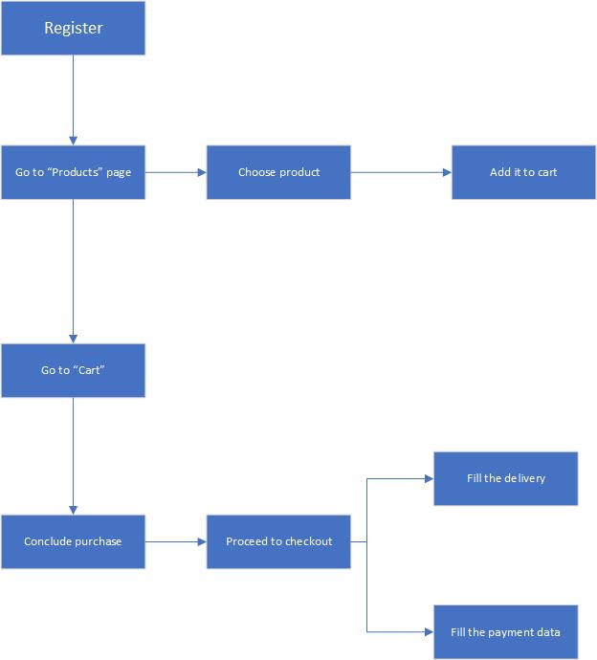
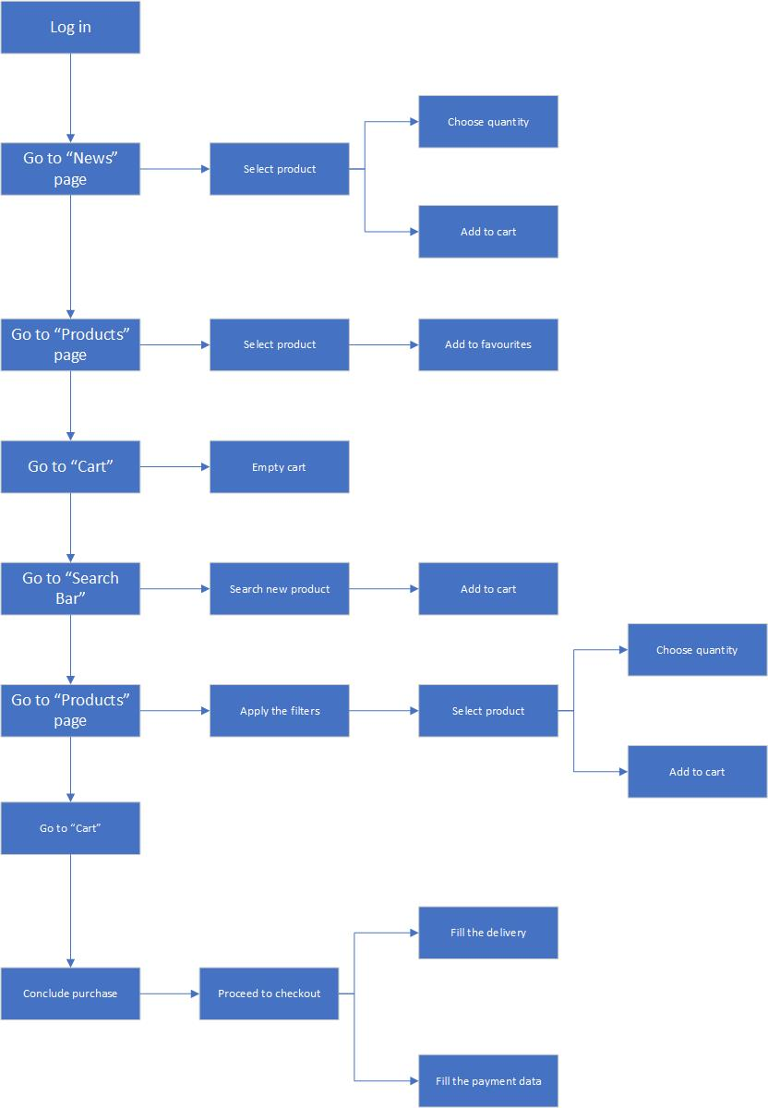
4. Tasks
Website for selling Hygiene products and Equipment
Fig1. Carlos’ tasks
Fig2. Carla’s tasks
HCI 2022-2023
11

Slide 12
5. Requirements
Website for selling Hygiene products and Equipment
Non-functional requirements:
Speed
Reliability
Usability
Functional Requirements:
Authentication
Searching in search bar
Applying filters
Payment options
Delivery options
Add products to shopping cart
Favorites
Access information about us
Apply discounts
HCI 2022-2023
12

Slide 13
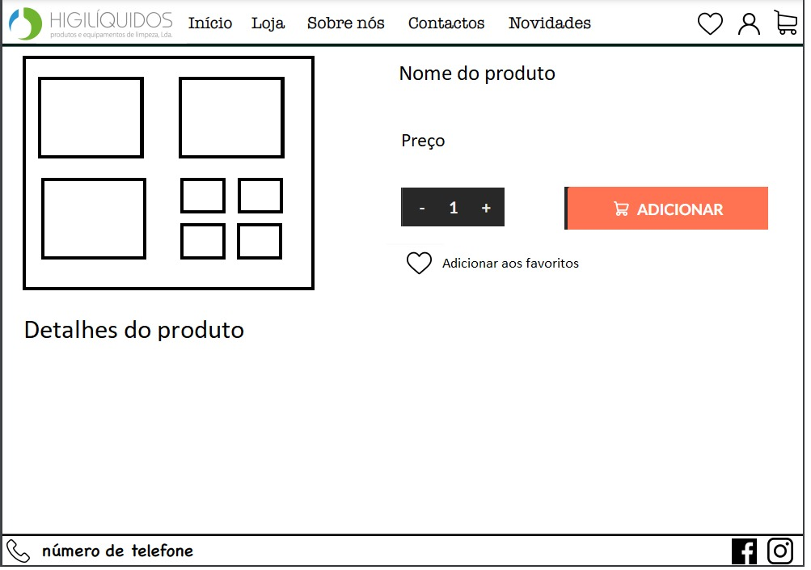
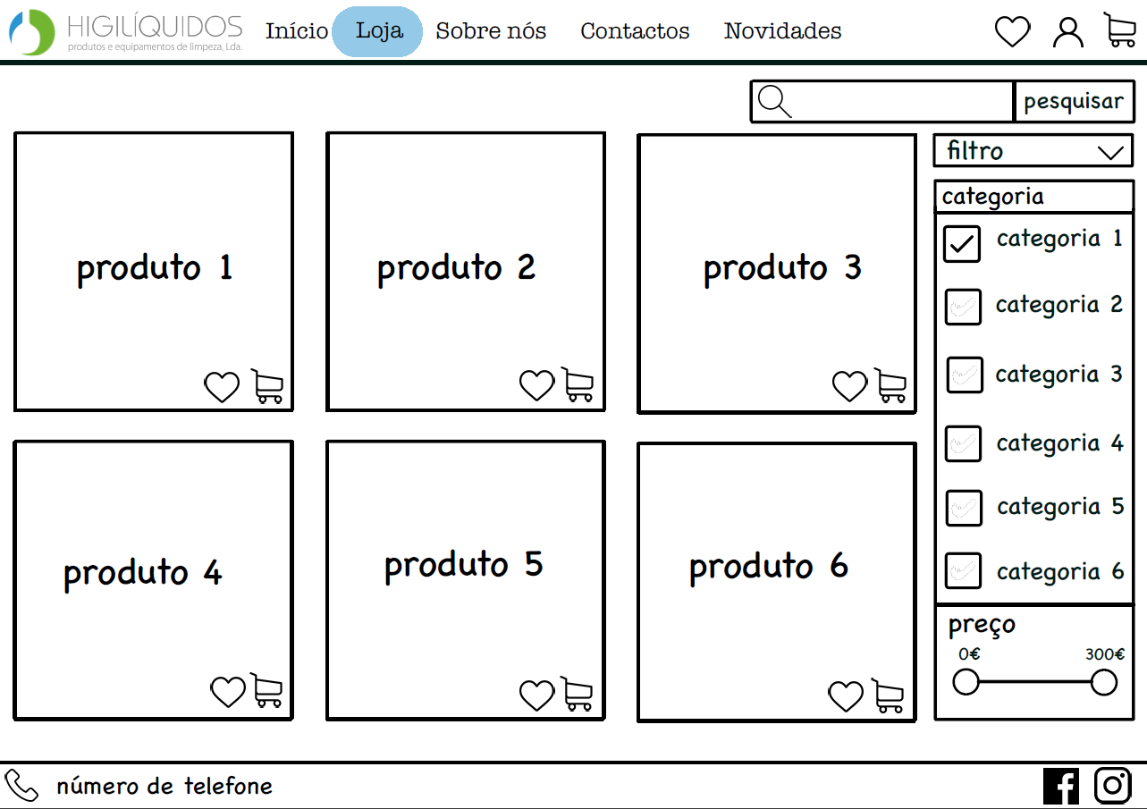
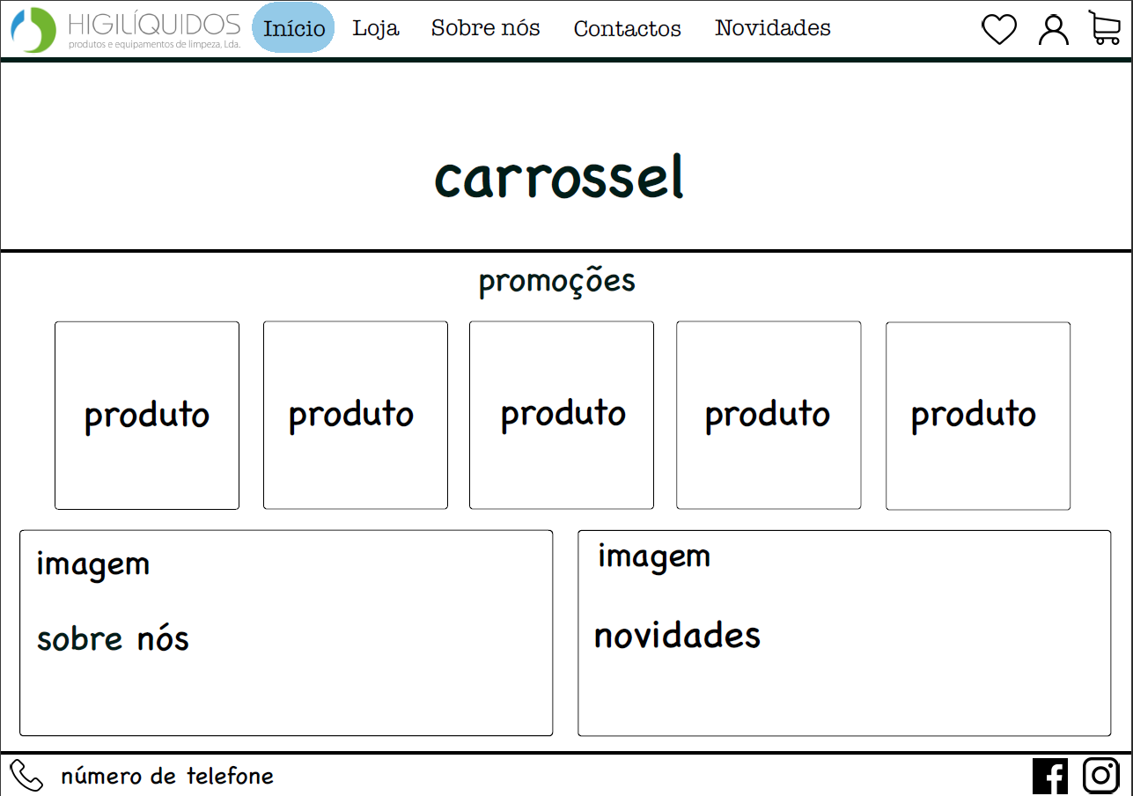
6. Low Fidelity Prototype (LFP)
Website for selling Hygiene products and Equipment
Creation of paper prototype to explore design ideas
HCI 2020 - 2021
13

Slide 14
7. LFP User Evaluation
Website for selling Hygiene products and Equipment
We wanted to evaluate the main features of the prototype, using all the personas and scenarios
Tasks:
Register as a new user
Select a product to buy
Select quantity (5) and add to cart
Check cart
Apply discount "get5“
We had 16 participants with approximately 20 years of age
New features suggested by the participants:
First page to appear is the home one and then click on the login/register button
Login and register on separate pages
Search bar on home page
HCI 2022-2023
14

Slide 15





8. Tools used for the functional prototype
Website for selling Hygiene products and Equipment
Programming Languages:
Other Tools:
HCI 2022-2023
15
Notes:
Simplicity and Accessibility: HTML is relatively easy to learn and understand, making it accessible to beginners. Its syntax is straightforward and intuitive, allowing developers to quickly create the structure and content of a web page.
Compatibility: HTML is supported by all major web browsers, ensuring compatibility across different platforms and devices. It enables your website to reach a wider audience without worrying about compatibility issues.
SEO-Friendly: HTML is search engine-friendly by nature. It provides the necessary structure and semantic markup for search engines to understand and index the content of your web pages effectively. This helps improve your website's visibility in search engine results.
Integration with Other Technologies: HTML can easily integrate with other web technologies such as CSS (Cascading Style Sheets) for styling and JavaScript for interactivity. This flexibility allows developers to create dynamic and interactive web pages by combining HTML with other technologies.
Wide Community and Resources: HTML has been around for a long time and has a vast and supportive community. This means there are abundant online resources, tutorials, and documentation available to help you learn and solve problems while developing your website.

Slide 16



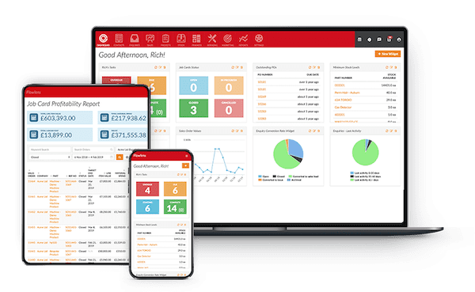
9. Reason of the Tools for the functional prototype
Website for selling Hygiene products and Equipment
Simplicity and Accessibility
Wide Community and Resources
SEO-Friendly
Compatibility
Integration with Other Technologies
HCI 2022-2023
16
Notes:
Simplicity and Accessibility: HTML is relatively easy to learn and understand, making it accessible to beginners. Its syntax is straightforward and intuitive, allowing developers to quickly create the structure and content of a web page.
Compatibility: HTML is supported by all major web browsers, ensuring compatibility across different platforms and devices. It enables your website to reach a wider audience without worrying about compatibility issues.
SEO-Friendly: HTML is search engine-friendly by nature. It provides the necessary structure and semantic markup for search engines to understand and index the content of your web pages effectively. This helps improve your website's visibility in search engine results.
Integration with Other Technologies: HTML can easily integrate with other web technologies such as CSS (Cascading Style Sheets) for styling and JavaScript for interactivity. This flexibility allows developers to create dynamic and interactive web pages by combining HTML with other technologies.
Wide Community and Resources: HTML has been around for a long time and has a vast and supportive community. This means there are abundant online resources, tutorials, and documentation available to help you learn and solve problems while developing your website.

Slide 17
10. Heuristic Evaluation on Functional Prototype
Website for selling Hygiene products and Equipment
 | Gonçalo | Miguel | Tiago
 | Severity | Severity | Severity | Average
Error Prevention (There is no confirmation message for some tasks) | 1 | 1 | 2 | 1
If we choose a brand filter it is only possible to reset it by reloading/changing the page | 2 | 2 | 2 | 2
Non Resposive to different window sizes | 4 | 3 | 3 | 3
Caption:
0. Not a Usability Problem
Cosmetic Problem
Minor Usability Problem​
Major usability problem​
Usability catastrophe​
HCI 2022-2023
17
Notes:
Simplicity and Accessibility: HTML is relatively easy to learn and understand, making it accessible to beginners. Its syntax is straightforward and intuitive, allowing developers to quickly create the structure and content of a web page.
Compatibility: HTML is supported by all major web browsers, ensuring compatibility across different platforms and devices. It enables your website to reach a wider audience without worrying about compatibility issues.
SEO-Friendly: HTML is search engine-friendly by nature. It provides the necessary structure and semantic markup for search engines to understand and index the content of your web pages effectively. This helps improve your website's visibility in search engine results.
Integration with Other Technologies: HTML can easily integrate with other web technologies such as CSS (Cascading Style Sheets) for styling and JavaScript for interactivity. This flexibility allows developers to create dynamic and interactive web pages by combining HTML with other technologies.
Wide Community and Resources: HTML has been around for a long time and has a vast and supportive community. This means there are abundant online resources, tutorials, and documentation available to help you learn and solve problems while developing your website.

Slide 18
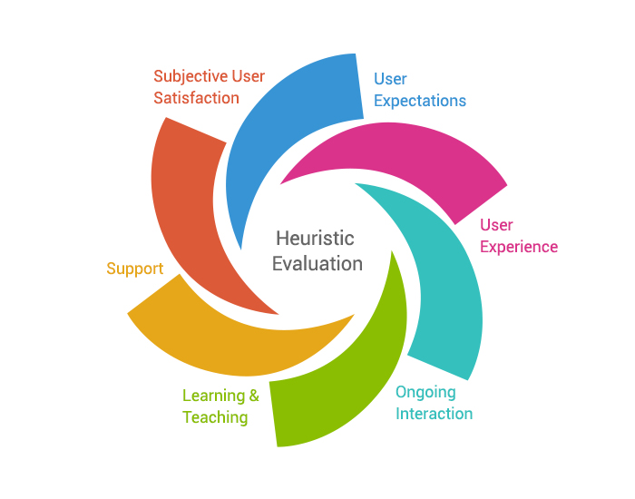
11. User Evaluation of the functional prototype
Website for selling Hygiene products and Equipment
Evaluated the main features of the prototype, using all the personas and scenarios
Tasks:
Register as a new user
Use filters and Search bar
Select a product to buy
Select quantity (5) and add to cart
Check cart
Proceed to checkout
16 participants with approximately 20 years of age
HCI 2022-2023
18

Slide 19
HCI 2022-2023
19

Slide 20
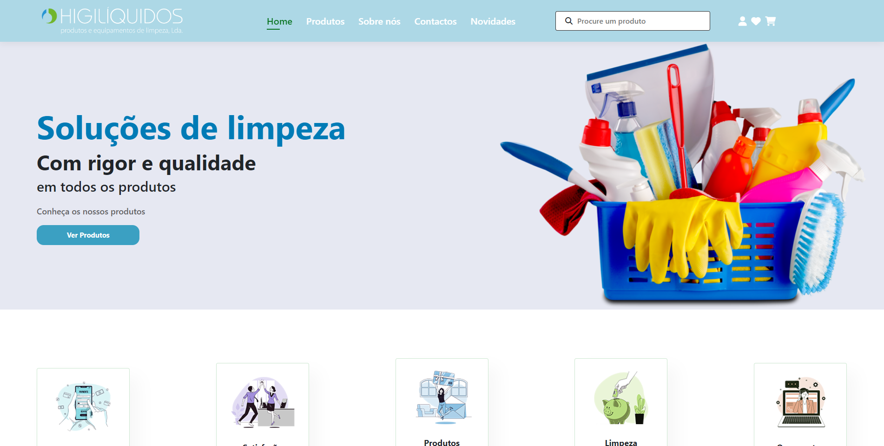
12. Demo
Demonstração
Prática
HCI 2022-2023
20

Slide 21
13. Future work
An eventual continuation of this project could focus on, for example:
Implement a database for the orders with details for shipment like address, NIF or delivery time, for instances
Modifying certain UI components to enhance accessibility for individuals with color vision deficiencies
Creating a resilient backend system to ensure complete functionality
14. Effort of each group member
All group members contributed equivalent time and effort to the development of this project.
HCI 2022-2023
21

Slide 22
15. Acknowledgments
We would like to extend our sincere gratitude to the following individuals:
All participants who generously dedicated their time to participate in usability testing and provided invaluable feedback.
The maintainers of the open-source frameworks and libraries utilized in our project, whose ongoing efforts and contributions were instrumental in its development.
Our HCI (Human-Computer Interaction) teachers, who graciously answered our inquiries and offered invaluable suggestions throughout the process.
We appreciate the valuable contributions and support from each of these individuals, which have significantly contributed to the success and improvement of our project.
16. Bibliography
Cooper, A., R. Reimann, and D. Cronin, About Face 3 The Essentials of Interaction Design. Wiley Publishing, Inc., 2007
w3schools
Stack Overflow
HCI 2022-2023
22

